Slide 1
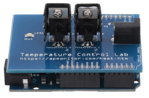
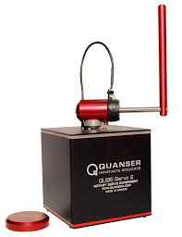
Integrated Modeling, Identification, and Control of Thermal and Mechanical Dynamics using Educational Control Platforms
Presenter: David C. Johnson
Advisors: Dr. Lu, Dr. Imtiaz
Faculty Reviewer: Dr. Malinowski
Department of Electrical and Computer Engineering, Caterpillar College of Engineering and Technology
4/06/2026

Slide 2
Outline
Happy Accident gave rise to Learning about Control Systems via TCLab
Part1: TCLab-Temperature Control
The TCLab System Description
Open-Loop Modeling: Step Response Experiment
Closed-Loop Modeling
Model Validation
Controller Design
PID Control Design, Data, and Plots
Conclusion
Part 2: Quanser Qube Servo2
Quanser Lab Description
Interfacing/Filtering
PID Control Design
Stability
Swing UP Energy Control Model
PID Control Design, Data, and Plots
Controller Design
Conclusion

Slide 3
Introduction
Motivation
• Feedback systems regulate physical processes: integrating the following two experimental platforms (as seen below).
Two experimental platforms used:
Thermal system (TCLab)
• Slow first-order dynamics
Electromechanical system (QUBE Servo 2)
• Fast nonlinear dynamics

Slide 4
Purpose
4
The TCLab © technology as an educational platform
Used to illustrate modeling of a control system pertaining to temperature.
The factors: convection, conduction, and radiation discussed
Predict temperature behavior of the system given carefully timed input step signals. Block Diagram Shown.
The Quanser Qube Servo2 as an educational platform
Used here to illustrate modeling of a control system pertaining to the swinging behavior of a pendulum.
PID control of the system and Stability of the System
Control the behavior of the pendulum given input/output model
Block diagram/Simulink Model.

Slide 5
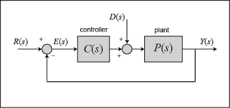
Feedback Control System Review
Closed Loop Feedback Control systems are essential in modern engineering applications where stability, robustness, and performance are required under uncertainty and disturbance.
Reference: The desired target value the system is trying to reach.
Error: The difference between the reference and the actual output.
Controller: The algorithm that computes the control action based on the error.
Plant: The physical system being controlled, whose behavior the controller influences.
Typically: r(t) → Controller → Plant → Sensor → Feedback

Slide 6
Part 1: Temperature Control TCLab
Part 1 Goal: What Will Be Built?
Develop a thermal model of the TCLab
Identify system parameters from step‑response data
Design and tune a PID controller
Validate the controller against real hardware
Compare model predictions to measured data

Slide 7

Modeling: Lab A-G Specifics
Labs A to G Controller performance: evaluated using time-domain metrics and error criteria, including Integral Absolute Error (IAE). (Typical for PID controller feedback systems)
e(t)=r(t)−y(t) r(t): reference (setpoint) y(t): system output
∣e(t)∣: absolute value of the error
T: total time of observation
Experimental results (a data set) are compared against theoretical predictions to assess model fidelity and control effectiveness.
Objective:
Develop a mathematical model of the thermal system.
Identify system parameters experimentally: (output: T=Temperature)
(input: Q=Heater)

Slide 8
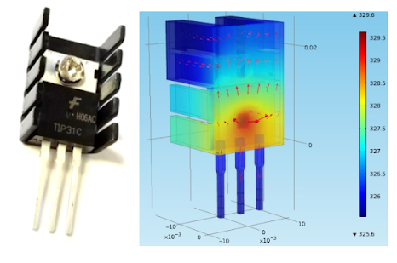
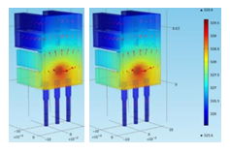
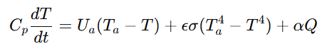
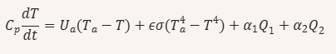
Typical TCLab Modeling: Lab Data - One and Two Heater
:Open Loop Equation Development - Analysis
“Derive a nonlinear transient model and fit a linear first-order or second-order system. Compare model predictions to transient lab data.”
The governing energy balance equation given is:
One heater:
Total convection radiation heater
Two heater:
Total convection radiation heater1 & 2
This is a first‑order nonlinear ODE. It directly expresses conservation of energy.
It includes convection, radiation, and heater input.
It is nonlinear because of the T⁴ radiation term.
It predicts the true temperature trajectory for any heater input.

Slide 9
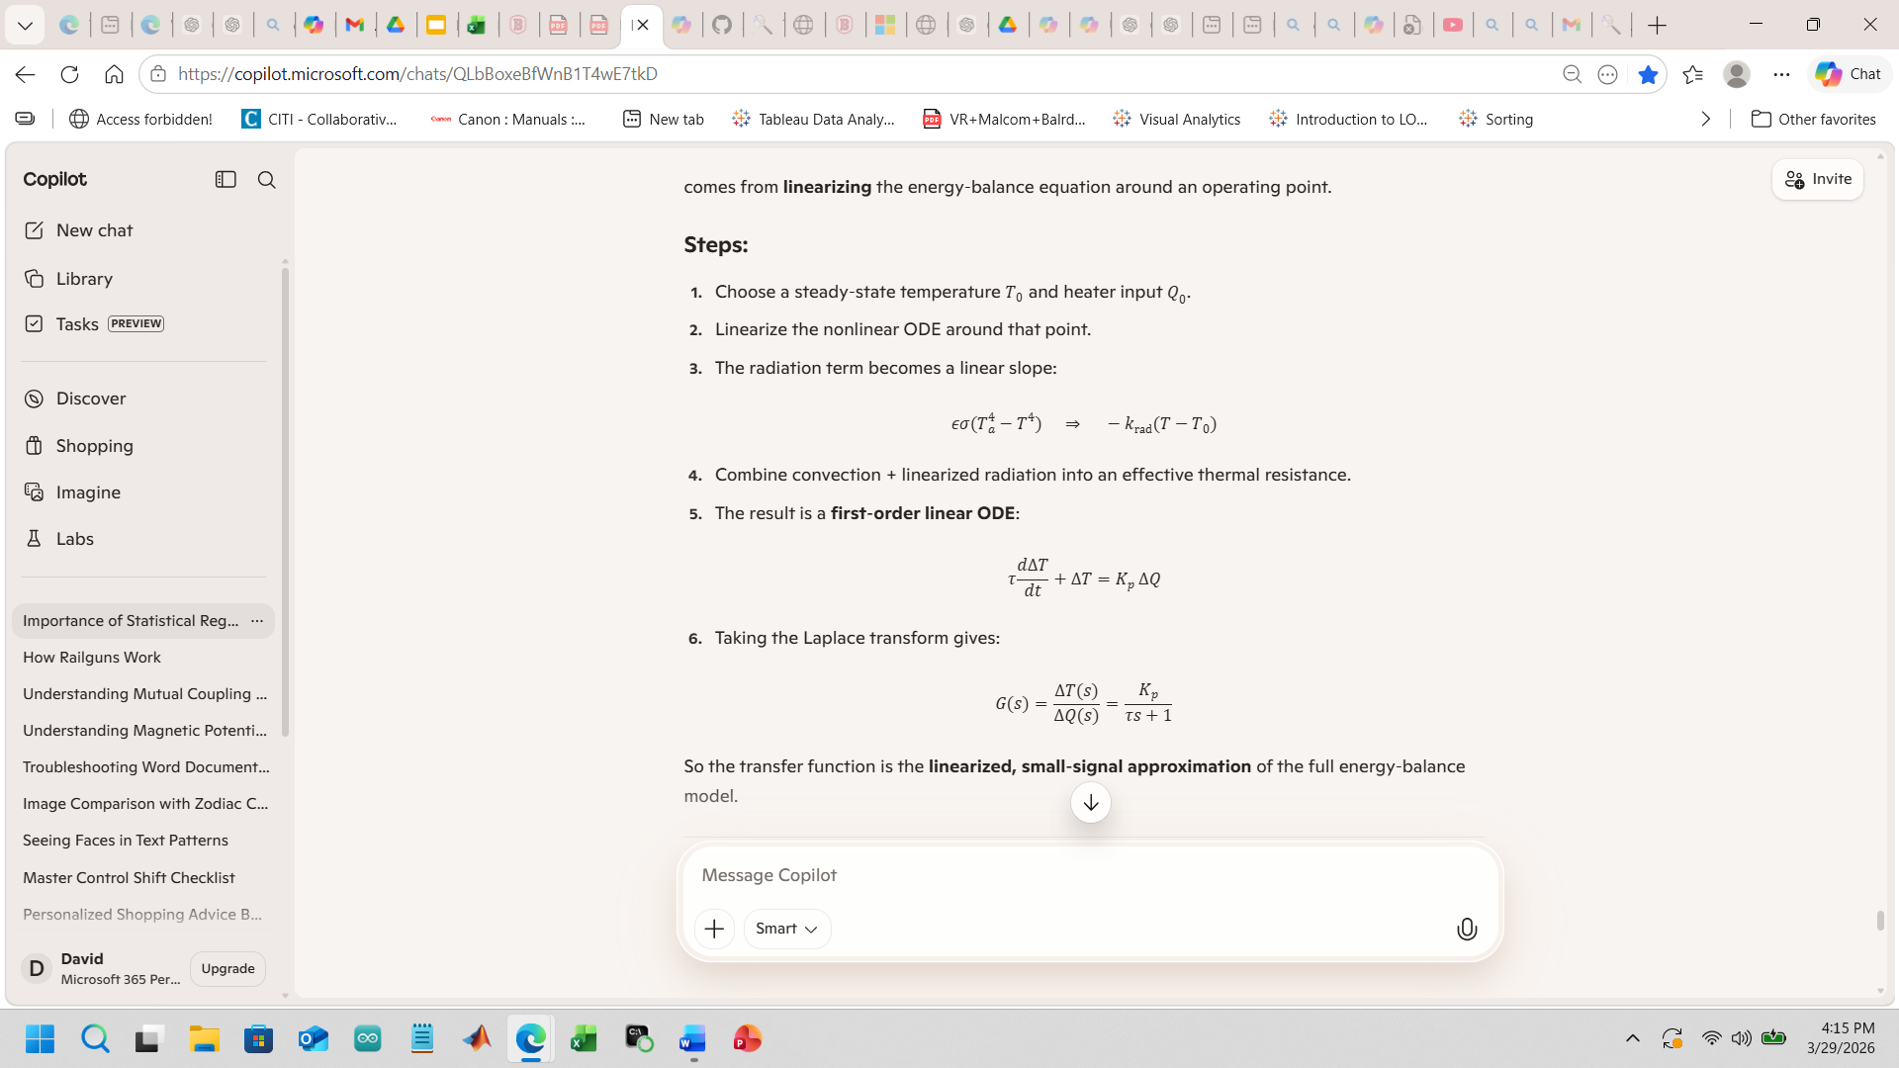

How is this Useful?
Linearize the energy‑balance equation around an operating point.
Steps:
Choose a steady‑state temperature T₀ and heater input Q₀.
Linearize the nonlinear ODE around that point.
The radiation term becomes a linear slope:

Slide 10

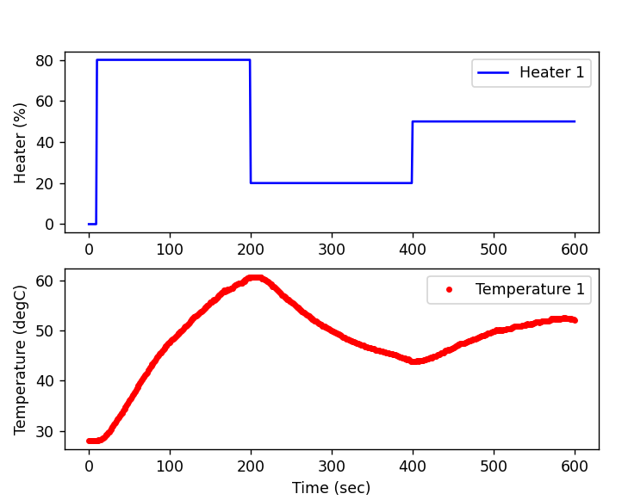
Objective: Generate Step
Generate a step input and analyze the closed‑loop response of:
Lab A: Single‑heater system.
Labs B–G: Two‑heater interactions and multivariable effects.
Emphasis throughout: parameter estimation, transfer‑function modeling,
and feedback design.

Slide 11
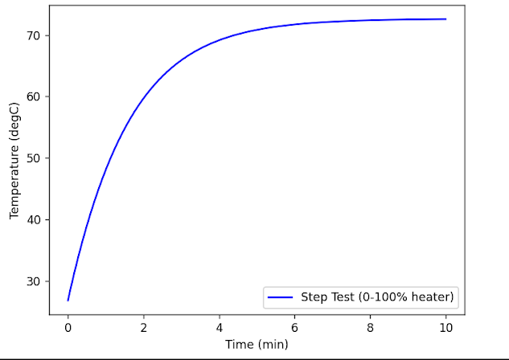
Step Response: What the Data Shows
A step input in heater power was applied, and temperature response was recorded.
Slow first‑order rise
No oscillation
Clear dead time (delay)
Steady‑state gain identifiable
Speaking of Deadtime or Delay in heating

Slide 12

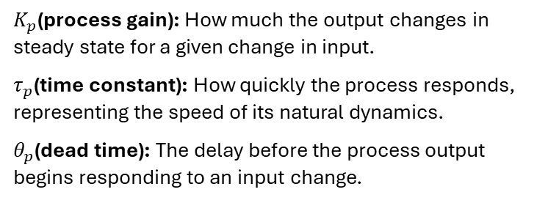
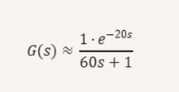
Including Process Deadtime
Time for heater to heat up
Because Real Thermal systems have transport delay
(Dead Time) where in this case:
Kp is 1
Tau is 60 sec
Theta is 20 sec
Delay caused by the heater slowly rising in temperature: a first order-plus-dead-time (FOPDT) model is identified from experimental step-response data collected via an Arduino microcontroller with dual heaters and temperature sensors.
Notes:
There is no Controller as of yet!

Slide 13
Key Insights
Now that we understand the TCLab system, we collect step‑response data to characterize its dynamics using two models.
Why Two Models?
FOPDT: Simple, fast to tune, good for single‑heater control
Energy balance: Physics‑based, captures cross‑coupling, needed for two‑heater systems
Comparison goal: Evaluate accuracy vs. complexity
Other models like the Moving Horizon, 2nd Order Model, ARX (AutoRegressive) model, and Neural Network were
beyond scope of this presentation

Slide 14
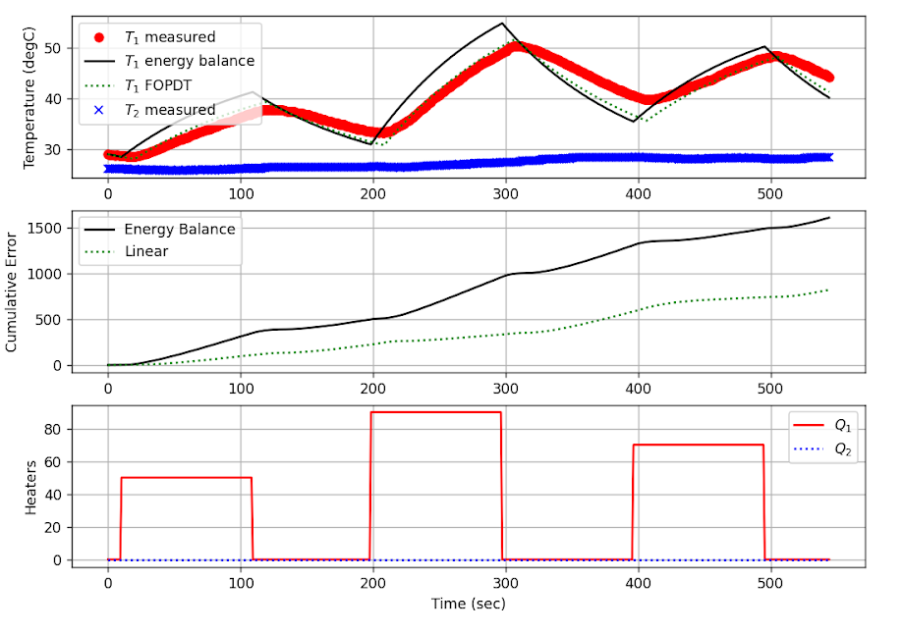
Heater Plot Explained
The step time was chosen to be roughly 1–2 time- constants
Dominant first-order thermal dynamics identified
Panel 3) Heater power inputs Q₁ and Q₂ (off) over time. These signals represent the applied heating profiles that drive the temperature dynamics shown in the upper panels.

Slide 15
Heater Plots (cont)
Panel 1) Measured and modeled temperature response for T₁ and T₂(flat). The plot compares the experimental temperature data (T₁ measured, T₂ measured) with two model predictions: the full energy‑balance model (-) and the first‑order‑plus‑dead‑time (FOPDT) approximation. Shows how well each model captures the heating dynamics under the applied heater inputs.
Notes:
The energy‑balance model is “better” because it contains the actual physics of heat transfer, while the FOPDT model is only a behavioral approximation fitted to one specific step test.

Slide 16
Heater Plot (cont)
Panel 2) Cumulative error between measured temperatures and model predictions. The energy‑balance model exhibits lower accumulated error over time compared to the linear FOPDT model, indicating a more accurate representation of the system’s thermal behavior.

Slide 17
Key Insights
With a validated open-loop model, we now design a PID controller to regulate temperature. But,
Why We Need a Controller
Maintain temperature despite disturbances
Achieve fast rise time with minimal overshoot
Reject noise and ambient fluctuations
Track changing setpoints
Notes:
Once the open‑loop model is identified, we use it to design and tune the PID controller. The open‑loop parameters determine how aggressively the controller can act without destabilizing the system.

Slide 18
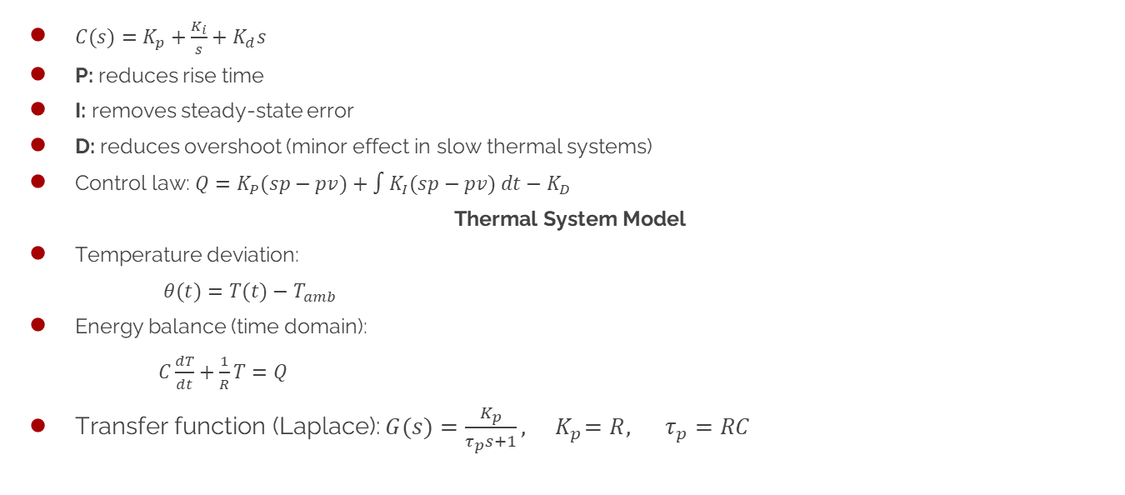
PID Controller TCLab Theory
Control Law: mathematical bridge between the physics of the thermal system (the energy‑balance equation) and the action of the PID controller (the voltage or heater power actually applied).

Slide 19
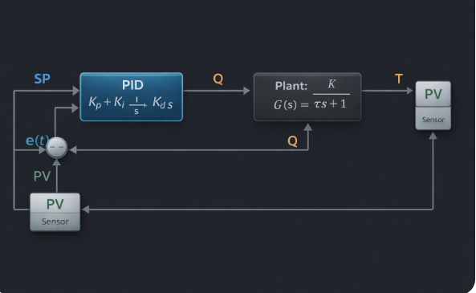
PID Temperature Block Diagram

Slide 20
Testing the Controller on Real Hardware
Apply step changes in setpoint
Record temperature and heater output
Compare measured response to model predictions

Slide 21
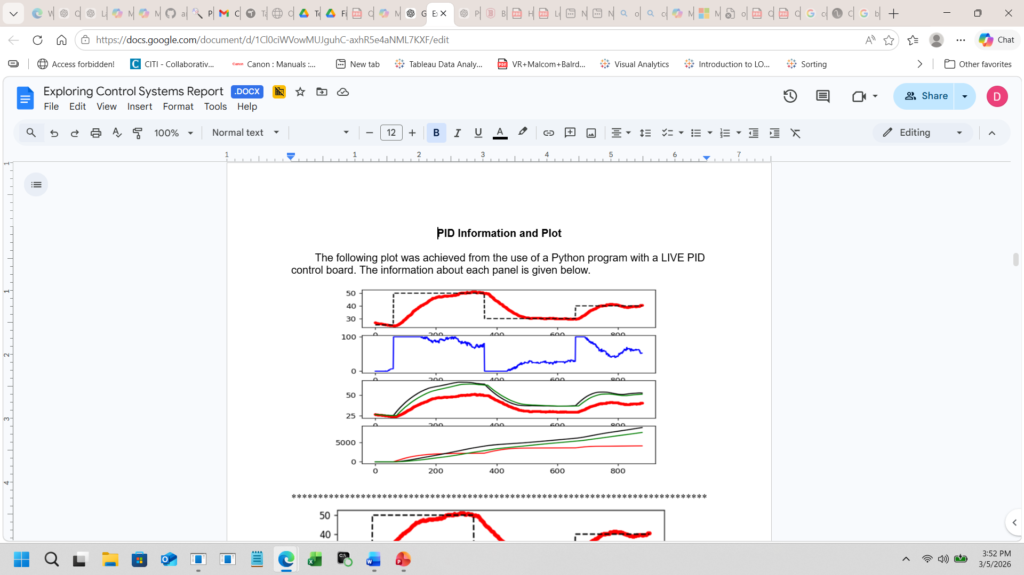
PID Information and Plot
LIVE PID
Data and Plot
Panel 2 (blue)
Not Analog: rapidly switching ON and OFF (pulse-width modulation)
Heater 1 output (% power)
This is the controller effort.
Panel 1
The red dots represent the measured temperature T1 from the actual hardware, whereas the black dashed line indicates the Setpoint Tsp1. This comparison demonstrates the closed-loop tracking performance.
Rise Time The moment the red output first climbs from its starting value up to the reference level in the top panel.
Overshoot The amount by which the red response exceeds the dashed reference during its first peak.
Settling Time The point where the red response stops oscillating and stays within a narrow band around the reference for the rest of the run.
Steady‑State Error The final difference between the red output and the dashed reference once the response has fully settled.

Slide 22
PID Information and Plot
Panel 4
What it shows:
This evaluates model accuracy via prediction error; the energy balance model achieves the lowest error magnitude and variability.
Panel 3
Red dots: Real measured T1
Black line: Energy balance model prediction (Tp) tracks shape fairly well.
Green line: FOPDT model prediction (Tpl) observe both deviate slightly during large transients
This is the model validation plot.
The energy balance model provides the closest match to the measured response.
Kp=10,Ki=0.2,Kd=10

Slide 23
Part 1 TCLab Conclusions
FOPDT model captures main dynamics; but, energy balance model is more accurate
PID controller achieves stable tracking with minimal overshoot
Real data matches model predictions closely
TCLab provides a reliable platform for teaching modeling and control

Slide 24
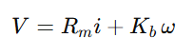

PART 2 – Quanser QUBE-Servo 2 System
DC motor-driven rotary arm equipped with a high-resolution encoder.
System components:
Input: Motor voltage (±10V)
Output: Angular position (rad)
Encoder resolution: 2048 counts/rev
Fast electromechanical dynamics
Unlike TCLab, this system is:
Fast
Sensitive
Quantized
Noise-prone when differentiating (produces sensor noise at high frequencies)
Voltage:
core physical laws that explain how the
QUBE‑Servo 2 converts electrical input (voltage) into mechanical motion (torque and angular acceleration).
Simple Block Diagram:
Voltage → Motor → Arm Dynamics → Angle → Encoder → Measurement

Slide 25
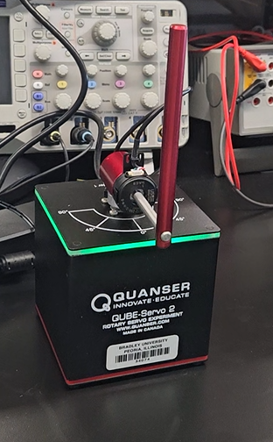
Demonstration
Live Swing Up (or possibly a video)
https://youtube.com/shorts/SxaPog4d3mc?si=RUAmaacKPETWITfL

Slide 26
Four Stages for Upright Pendulum Behavior:
1) Interfacing (Computer/Cube Communication)
2) Filtering (getting the ‘kinks’ out of the Communication)
3) PID (like TCLab needed to predict behavior through feedback)
4) Stability (speaks for itself)
After these 4 steps … Swing Up the arm!!!!
However, PID and Stability will be covered.
Computer
↓
DAQ interface
↓
Signal filtering
↓
PID controller
↓
Motor actuator
↓
Pendulum

Slide 27
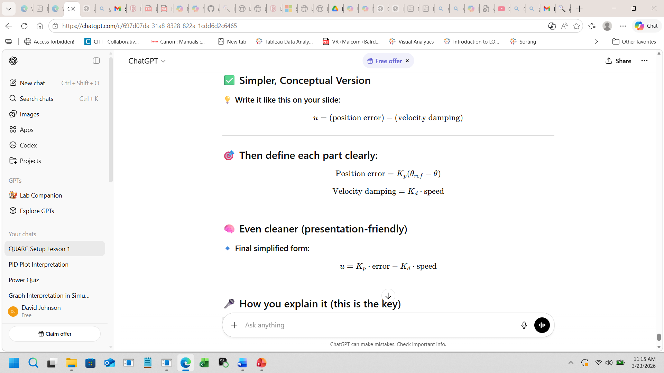
PID Controller for Quanser Qube Servo_2
This controller has two parts: First term drives system toward desired position based on the error between where we want to be and where it is.
Second term acts like damping slowing the system down based on how fast it’s moving, preventing overshoot and oscillations.
Shapes the motor arm into a stable, predictable subsystem required before any pendulum control
Uses proportional action for responsiveness and filtered derivative action to damp oscillations without amplifying encoder noise
Requires careful gain tuning, since high gains can easily introduce oscillation or drive the actuator into saturation
Must run with fixed‑step timing and include saturation limits to maintain safe, stable behavior: Mathematically -

Slide 28
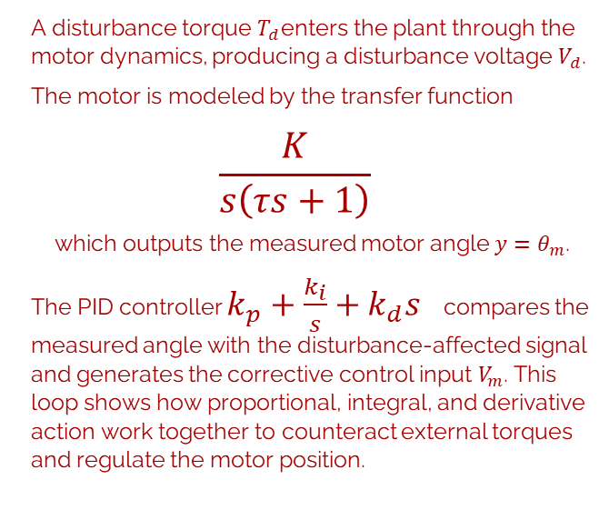
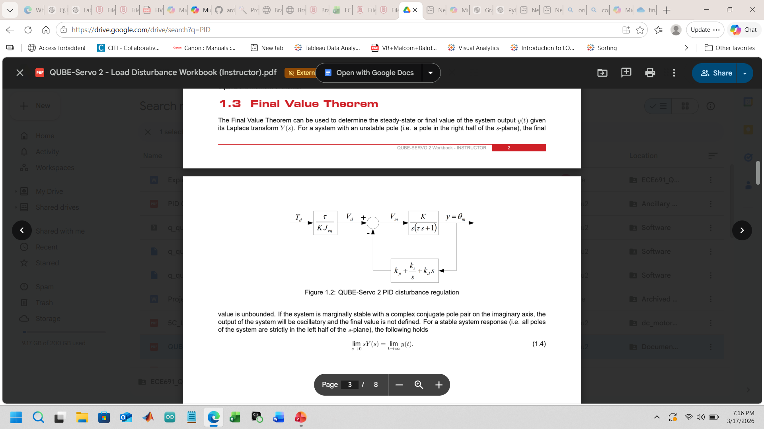
PID Block Diagram

Slide 29
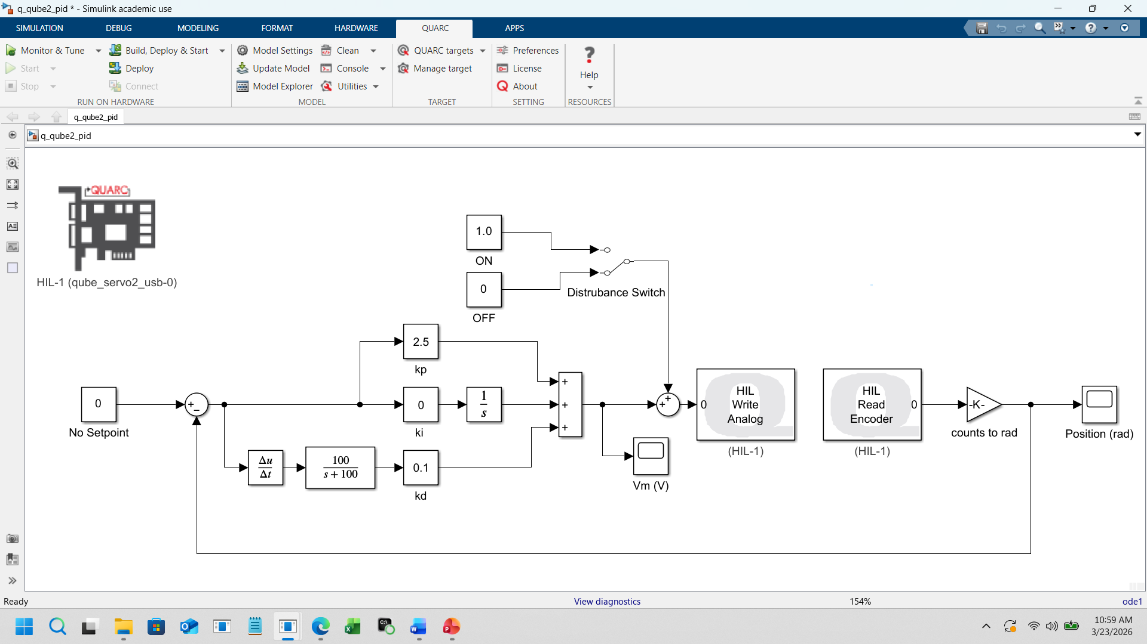
What Hardware‑in‑the‑Loop (HIL) Means for Simulink
Hardware‑in‑the‑Loop (HIL) is when a Simulink model runs in real time and exchanges signals directly with the physical QUBE hardware. Instead of simulating the plant, Simulink “talks” to the actual motor, encoders, and sensors during execution.

Slide 30
PID - Simulink Model
Procedure: Manually move the arm. It will resist motion around a set point.
Real‑time PID control using HIL: Simulink computes the control signal, the hardware responds, and the loop stabilizes the arm around the setpoint.

Slide 31
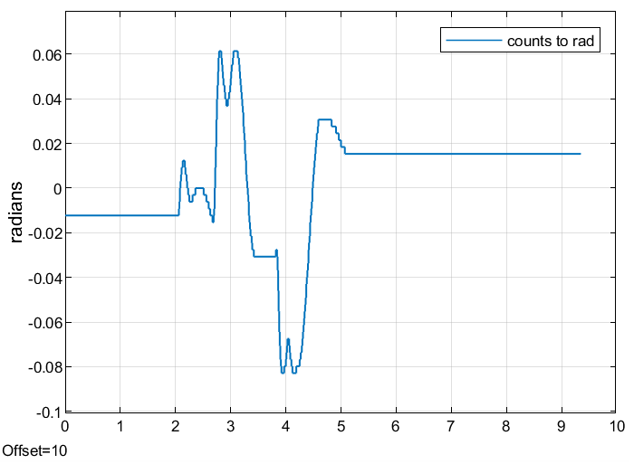
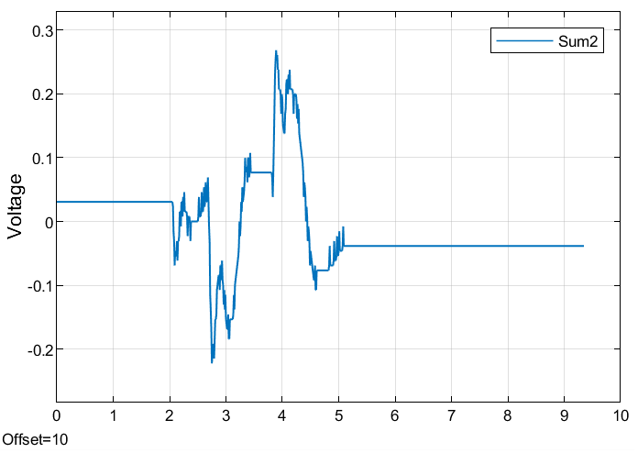
PID Graphs and Interpretation
Left Graph (Moderately Damped Response)
Shows a small overshoot with oscillations that decay smoothly.
Demonstrates a well‑tuned, stable PID response with good damping.
Right Graph (More Oscillatory Response)
Exhibits larger overshoot and slower decay of oscillations.
Indicates gains that are slightly too aggressive, producing a less‑damped response.
What Both Graphs Confirm
Volts inverted graph of position graph: expected.
The motor and encoder feedback behave correctly,
producing a stable, second‑order response
The PID loop is functioning properly with filtered
derivative action and no noise spikes
The arm dynamics are well‑behaved and ready for
swing‑up and upright control

Slide 32
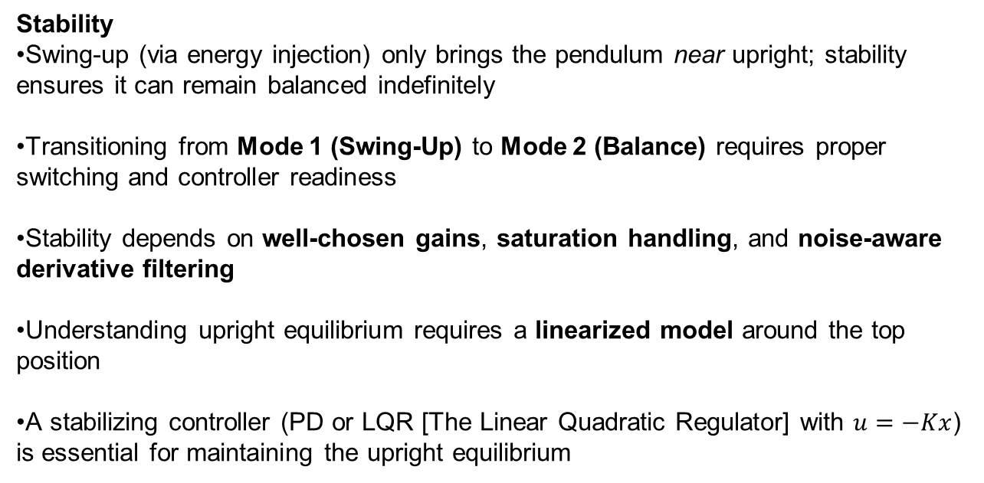
Stability Controller for Quanser Qube Servo_2
I

Slide 33
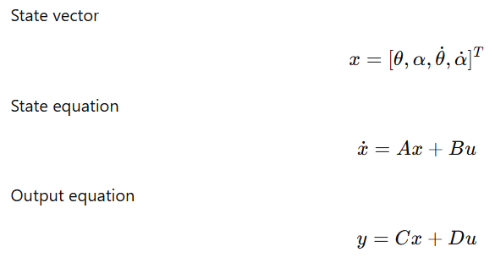
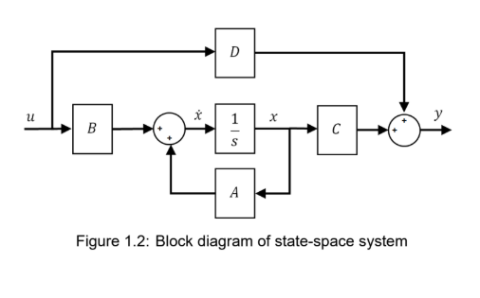
Linear State Space Model & Block Diagram
Expresses a system using internal variables (the states) rather than only inputs and outputs.
Essential for systems like the QUBE, where motion depends on angles and angular velocities, not just the current input.
collects all variables needed to describe the system’s instantaneous condition
describes how the system changes over time.
defines what you can measure.
θ: rotary arm angle
α: pendulum angle
θ˙,α˙: their angular velocities

Slide 34
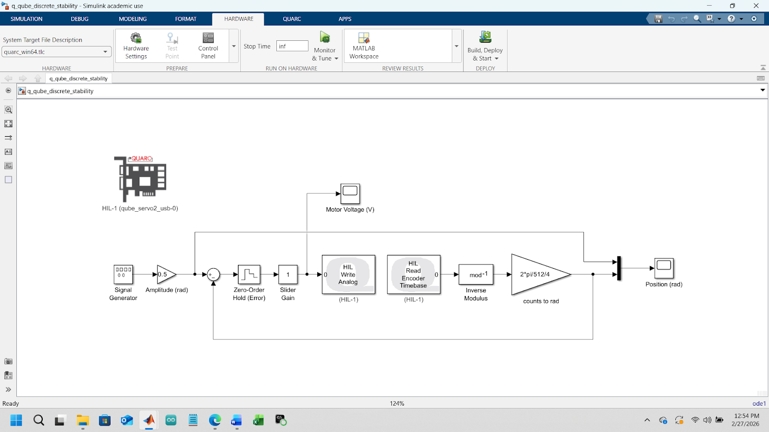
Stability - Simulink Model
HIL stability test: Simulink sends a test signal and the hardware returns the true motion, allowing real‑time assessment of system stability. Demonstrated through sinusoidal oscillations.

Slide 35
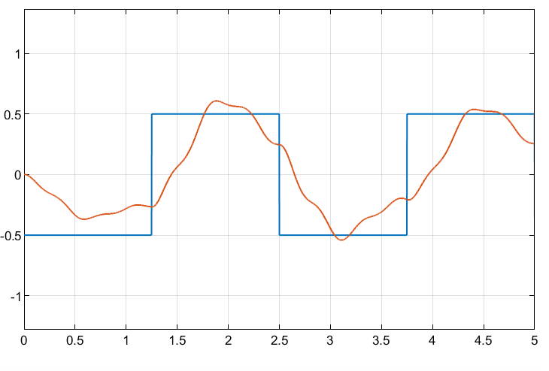
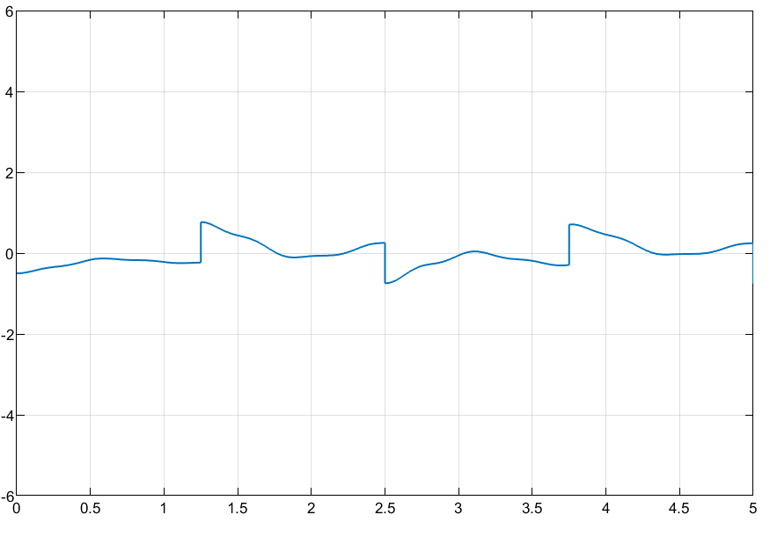
Stability Graphs and Interpretation
Left Graph: Position Response Stable, underdamped tracking with small overshoot
and decay
Right Graph: Control Input (Motor Voltage) Bounded and non-diverging → stable actuator behavior
The voltage signal is truncated at the actuator limits, meaning the controller demand exceeds the allowable range but is clipped to remain within ±Vmax.
Key Observations
Stable second-order behavior
Well-damped response
Control signal remains bounded

Slide 36
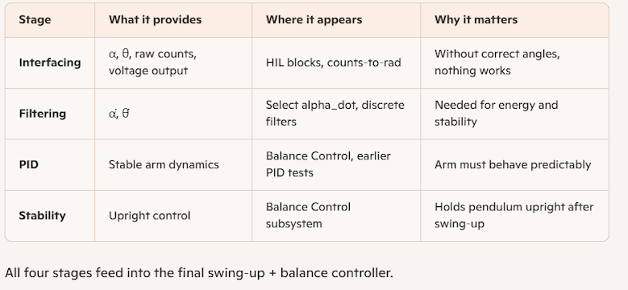
Combining all 4 Stages

Slide 37
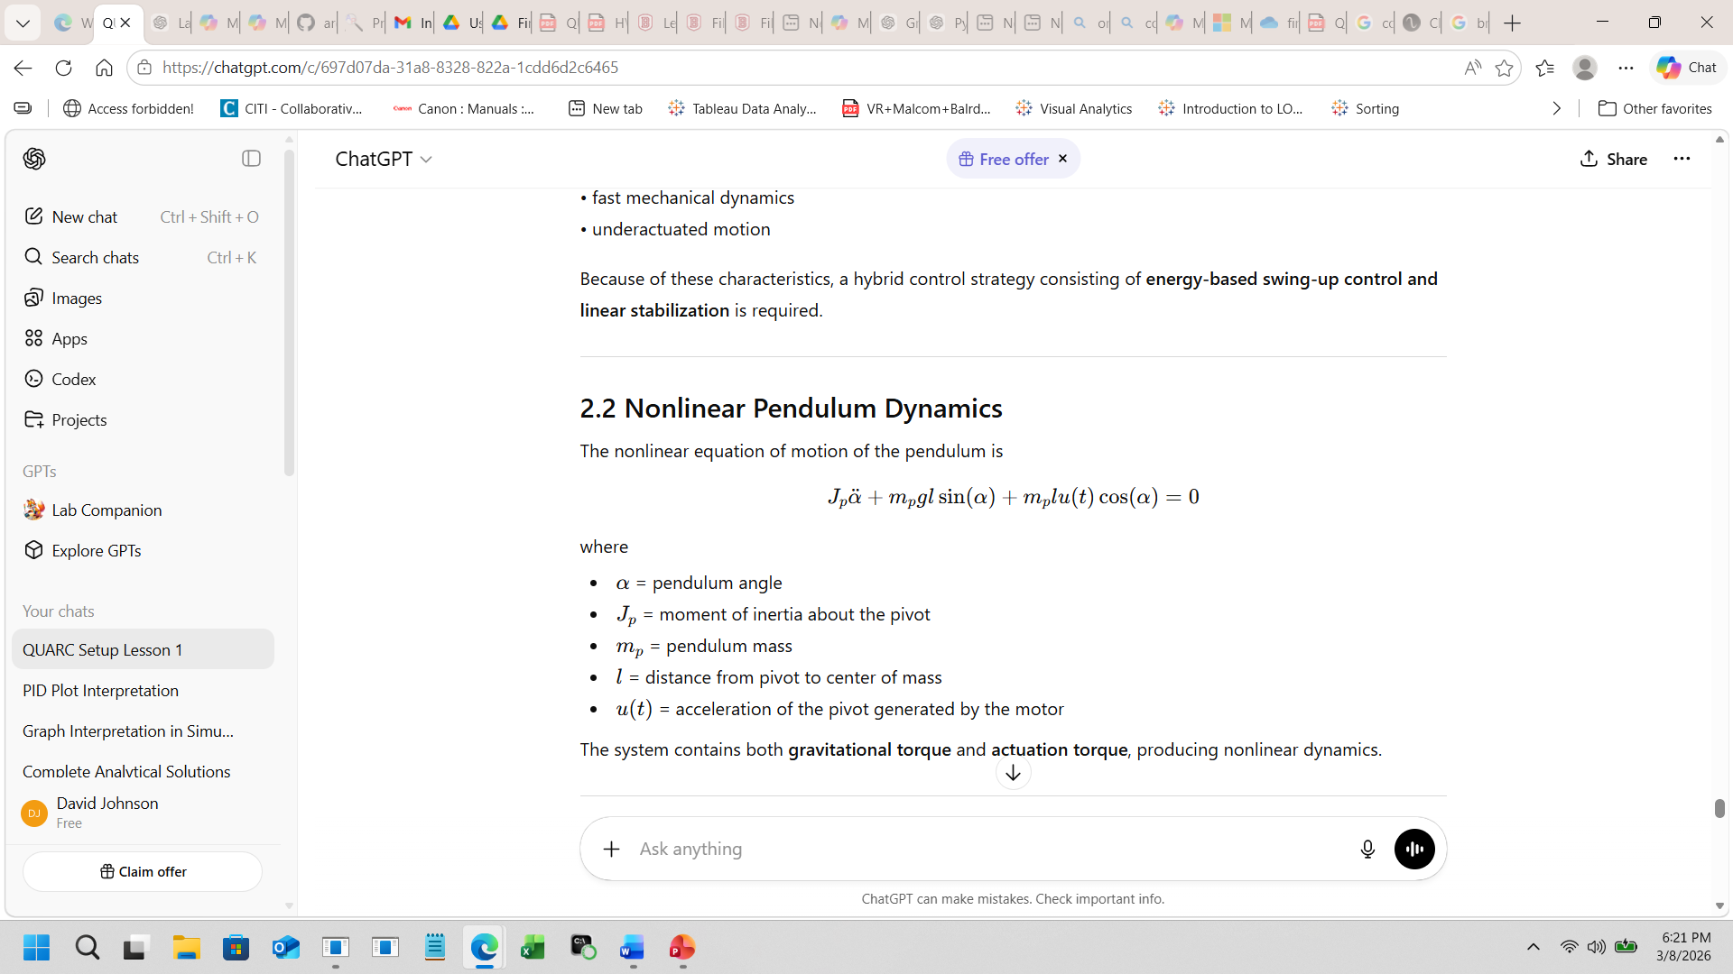
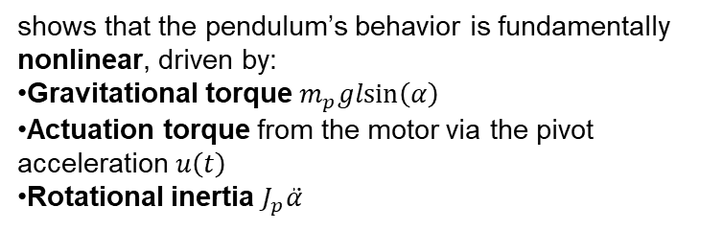
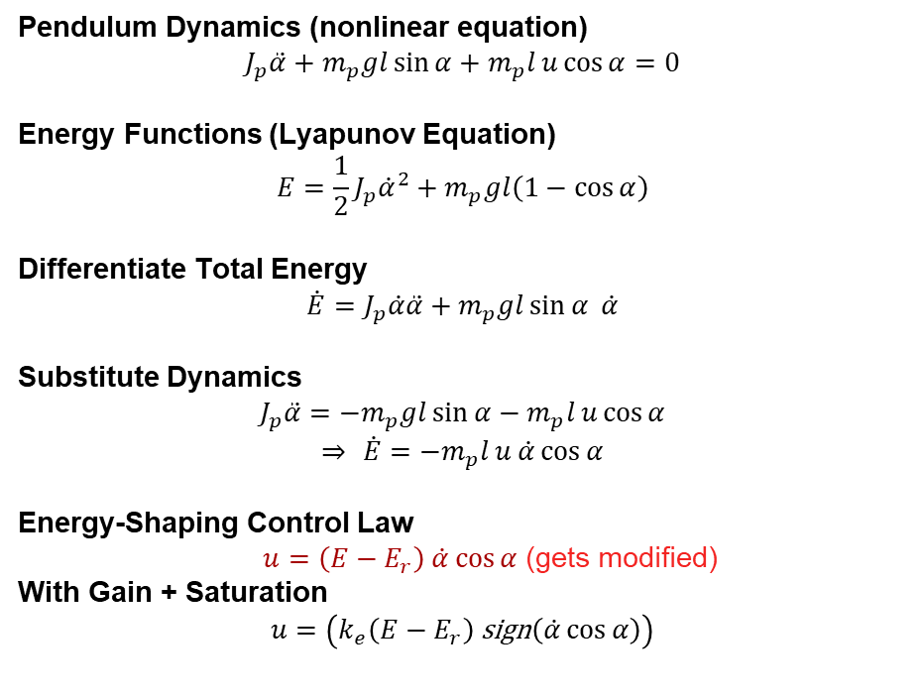
Swing‑Up Control: Lyapunov Energy Derivation
Key Idea
The slide shows how physics (nonlinear dynamics) and control strategy (energy shaping) work together to achieve the swing‑up phase before switching to a balancing controller.
This equation is a simple example of force‑balance modeling, illustrating the same principles—driving forces, resisting forces, and resulting acceleration—that underpin the more complex nonlinear dynamics and control laws used in the QUBE pendulum system.

Slide 38
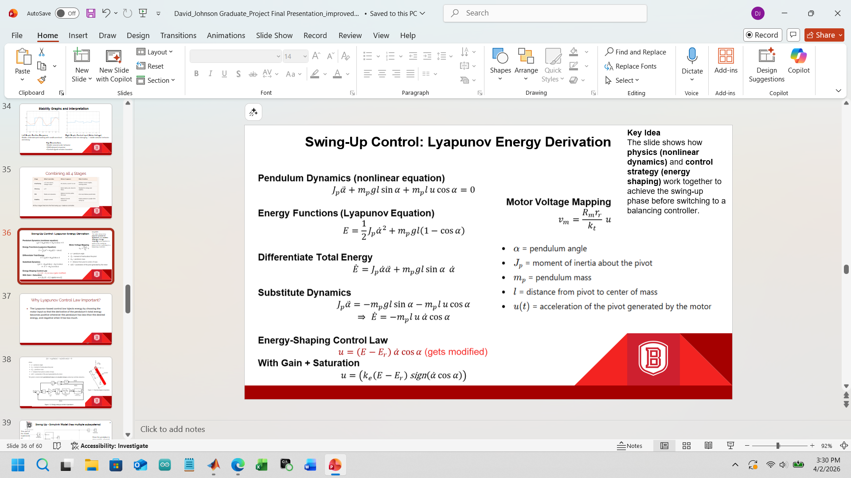
Why Lyapunov Control Law Important?
The Lyapunov‑based control law injects energy by choosing the motor input so that the derivative of the pendulum’s total energy becomes positive whenever the pendulum has less than the desired energy, and negative when it has too much.

Slide 39
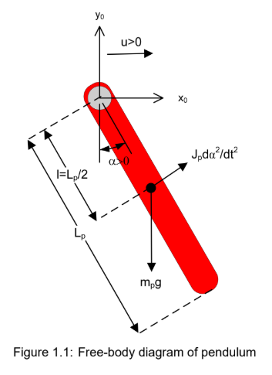
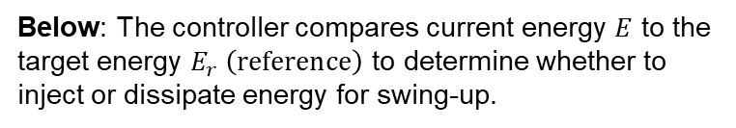
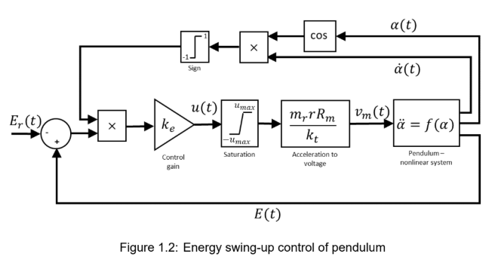

Slide 40

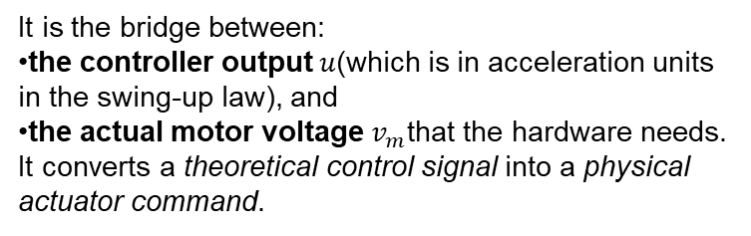
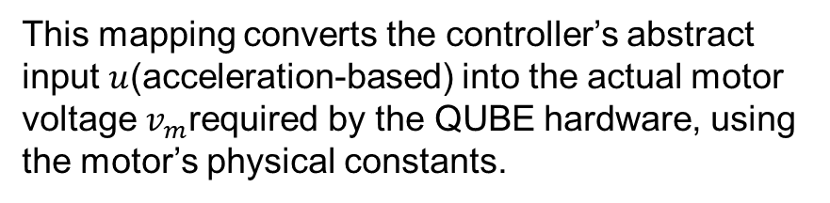
The Motor

Slide 41
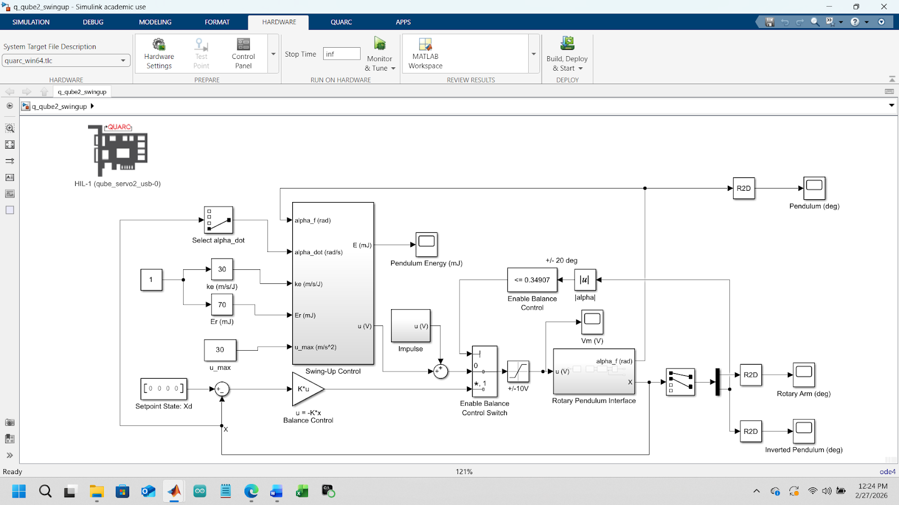
Swing Up - Simulink Model (has multiple subsystems)
This part of the model implements an energy‑based swing‑up law that drives the pendulum from hanging down to near upright by regulating its total energy.
Once the pendulum is near upright, a logical condition enables the balance controller, which uses state feedback to keep it balanced.
Notes:
“Once the pendulum is near upright, a logical condition enables the balance controller, which uses state feedback to keep it balanced.”

Slide 42
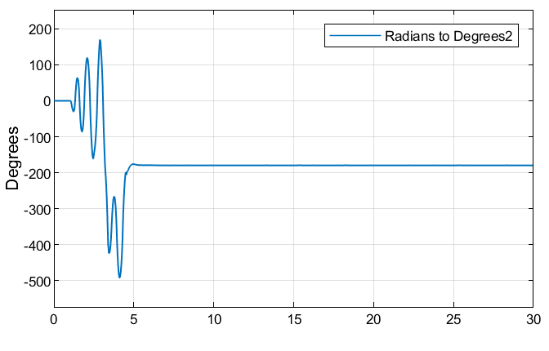
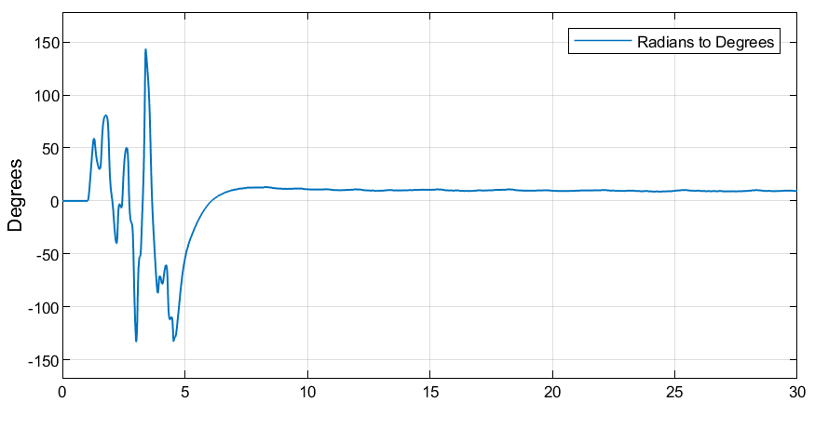
Swing Up Plot/Output and Interpretation
Pendulum Angle
Rotary Arm Angle
The arm moves aggressively during swing‑up to pump energy into the pendulum, then quiets down once the system transitions to stabilization.
Shows the pendulum swinging with large oscillations during energy injection, then settling near the upright position once balance control takes over. Shows that up is down and down is up in this case.

Slide 43
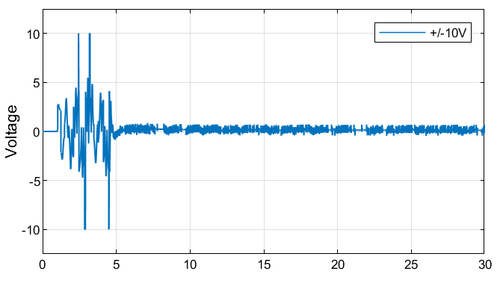
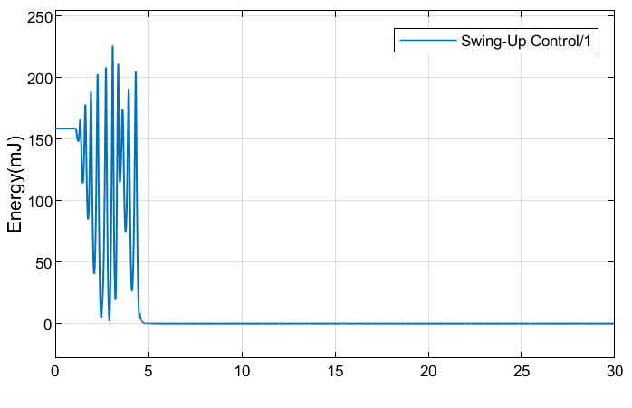
Applied Motor Voltage
Total Mechanical Energy
Voltage saturates between ±10 V during swing‑up, reflecting strong control effort, and then drops to small corrections once the pendulum is balanced.
Energy rises and oscillates as the controller injects energy, then levels off near the target value before switching to the balancing controller.

Slide 44
Part 2: Quanser Qube Conclusion
Modeling validated
Controllers implemented
Energy swing-up achieved
System stabilized

Slide 45
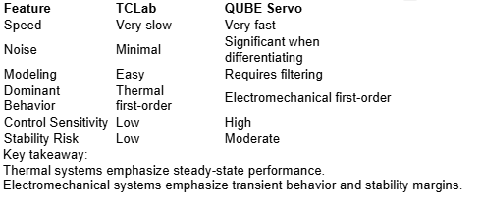
Comparative Discussion

Slide 46
Thank You ……. Any Questions?

Slide 47
After Presentation Slides

Slide 48
TCLab PID Controller Summary
Implemented using a Python program connected to a live temperature control board to evaluate closed-loop performance. The PID constant values were: kp=10, ki=0.2, kd=10
The temperature setpoint was stepped from 25 °C to 50 °C, then to 30 °C, and finally to 40 °C while the system response was recorded. The measured temperature closely tracked the setpoint with a fast rise time, minor overshoot near the 50 °C step, and smooth settling during the later transitions, indicating stable controller tuning.
The heater output plot shows the controller effort required to achieve this behavior, including a brief saturation near 100 % power during the large heating step and a drop to 0 % during cooldown, demonstrating effective integral windup protection.
Model validation via comparing the real temperature response to predictions from an energy balance model and a first-order plus dead-time (FOPDT) model. Both models captured the general system behavior, though small deviations appeared during larger transients.
Finally, error plots comparing tracking and model prediction errors provided an integrated view of performance over time, showing moderate tracking error growth and highlighting differences in predictive accuracy between the two models.

Slide 49
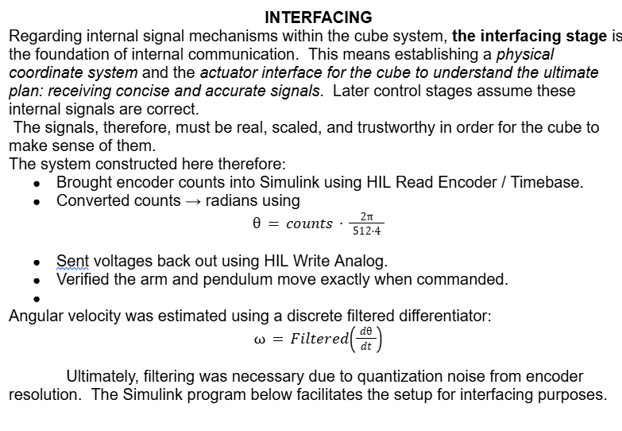
Interfacing

Slide 50
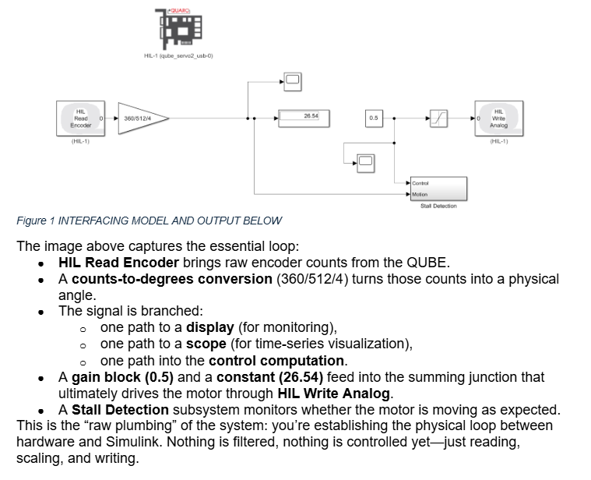
Interfacing Model

Slide 51
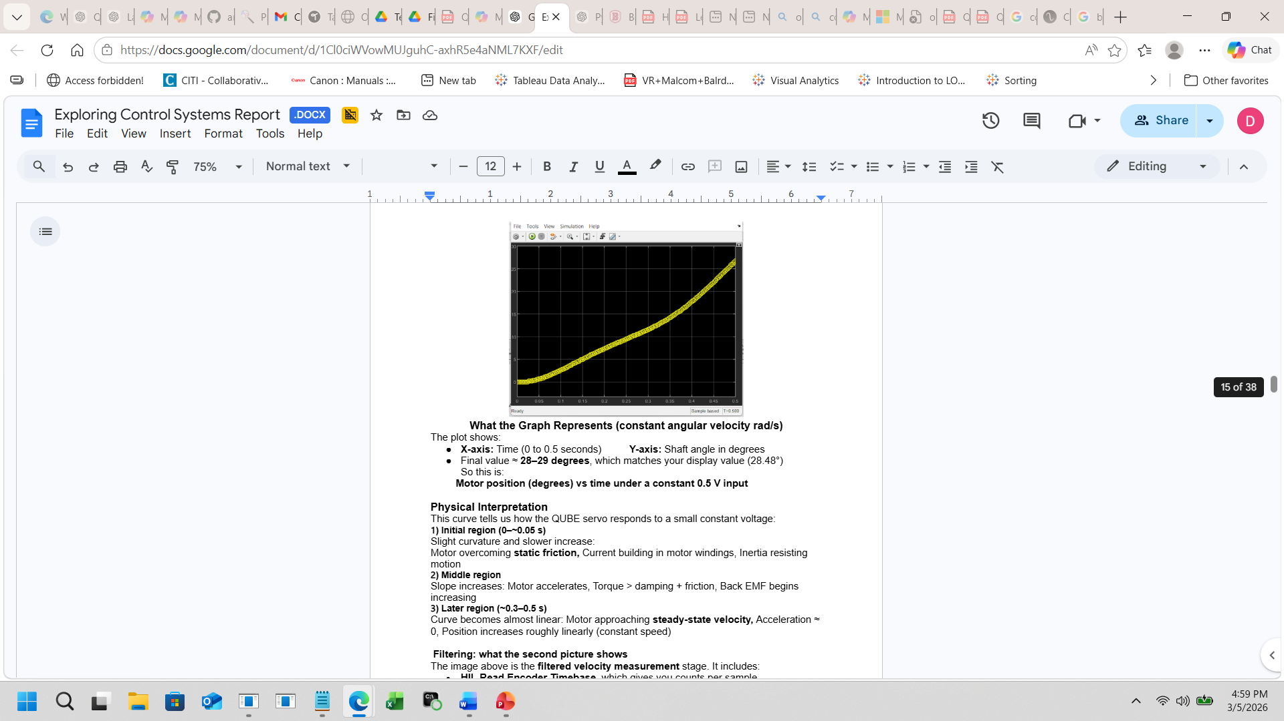
Interfacing Plot/Output and Interpretation

Slide 52
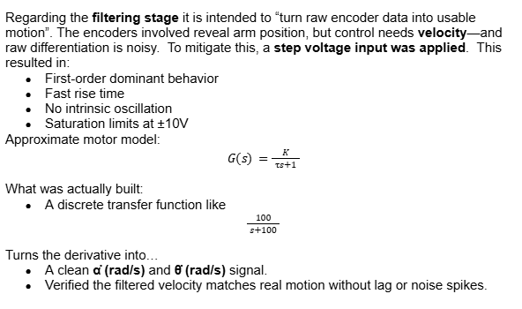
Filtering

Slide 53

Filtering Model

Slide 54


Filtering Plot/Output and Interpretation

Slide 55

Stability

Slide 56
Stability Model
Your stability-model screenshots capture the exact moment in your workflow where you moved from “controlling the motor” to “understanding and shaping the closed-loop dynamics.” The two images together show (1) the structure of the stability experiment and (2) the motor’s voltage response as the system tracks a sinusoidal reference. Here’s the full interpretation in context.
🧩 What the stability Simulink model is doing
This model is designed to test closed-loop stability of the rotary arm under a reference-tracking controller. It’s not yet the pendulum—this is the arm behaving as a controlled subsystem.

Slide 57


Stability Plot/Output and Interpretation

Slide 58

Swing Up

Slide 59




Swing Up Model: Lyapunov Stability Derivation

Slide 60
Swing Up Model: Theory

Slide 61
Swing Up Model

Slide 62


Swing Up Plot/Output and Interpretation

